Slide 1


Jesus R Rosila Mares
11 October 2022

Slide 2

Outline
Executive Summary
Introduction
Methodology
Results
Conclusion
Appendix

Slide 3
Executive Summary
Summary of methodologies
Summary of all results

Slide 4
Introduction
Project background and context
Problems you want to find answers

Slide 5

Section 1

Slide 6
Methodology
Executive Summary
Data collection methodology:
Describe how data was collected
Perform data wrangling
Describe how data was processed
Perform exploratory data analysis (EDA) using visualization and SQL
Perform interactive visual analytics using Folium and Plotly Dash
Perform predictive analysis using classification models
How to build, tune, evaluate classification models

Slide 7
Data Collection
Describe how data sets were collected.
You need to present your data collection process use key phrases and flowcharts

Slide 8
Data Collection – SpaceX API
Present your data collection with SpaceX REST calls using key phrases and flowcharts
Add the GitHub URL of the completed SpaceX API calls notebook (must include completed code cell and outcome cell), as an external reference and peer-review purpose
Place your flowchart of SpaceX API calls here

Slide 9
Data Collection - Scraping
Present your web scraping process using key phrases and flowcharts
Add the GitHub URL of the completed web scraping notebook, as an external reference and peer-review purpose
Place your flowchart of web scraping here

Slide 10
Data Wrangling
Describe how data were processed
You need to present your data wrangling process using key phrases and flowcharts
Add the GitHub URL of your completed data wrangling related notebooks, as an external reference and peer-review purpose

Slide 11
EDA with Data Visualization
Summarize what charts were plotted and why you used those charts
Add the GitHub URL of your completed EDA with data visualization notebook, as an external reference and peer-review purpose

Slide 12
EDA with SQL
Using bullet point format, summarize the SQL queries you performed
Add the GitHub URL of your completed EDA with SQL notebook, as an external reference and peer-review purpose

Slide 13
Build an Interactive Map with Folium
Summarize what map objects such as markers, circles, lines, etc. you created and added to a folium map
Explain why you added those objects
Add the GitHub URL of your completed interactive map with Folium map, as an external reference and peer-review purpose

Slide 14
Build a Dashboard with Plotly Dash
Summarize what plots/graphs and interactions you have added to a dashboard
Explain why you added those plots and interactions
Add the GitHub URL of your completed Plotly Dash lab, as an external reference and peer-review purpose

Slide 15
Predictive Analysis (Classification)
Summarize how you built, evaluated, improved, and found the best performing classification model
You need present your model development process using key phrases and flowchart
Add the GitHub URL of your completed predictive analysis lab, as an external reference and peer-review purpose

Slide 16
Results
Exploratory data analysis results
Interactive analytics demo in screenshots
Predictive analysis results

Slide 17

Section 2

Slide 18
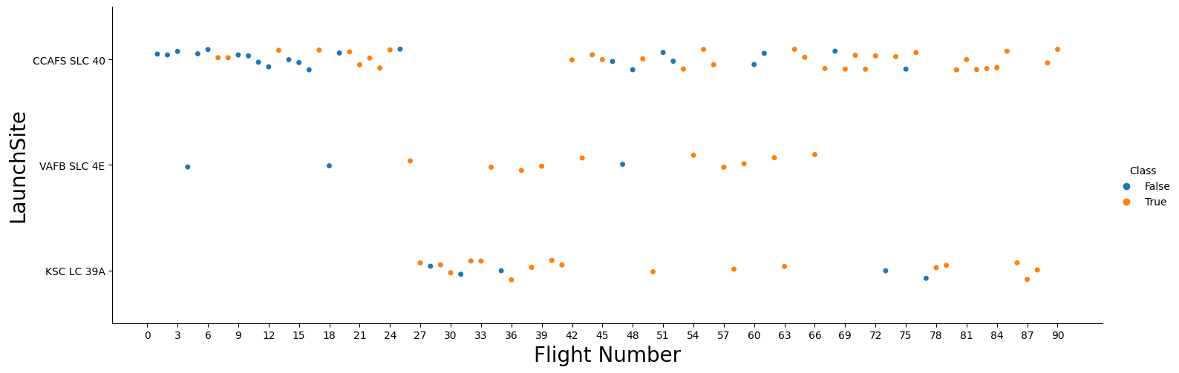
Launch Site vs. Flight Number

Slide 19
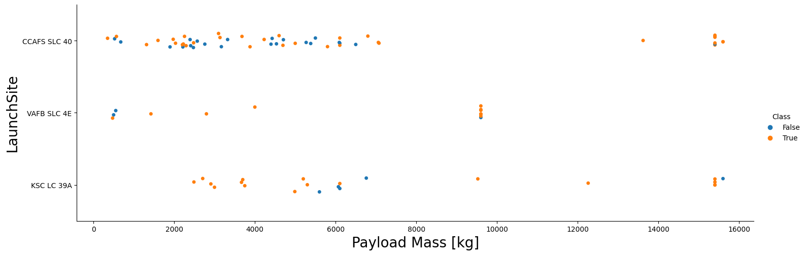
Launch Site vs. Payload

Slide 20
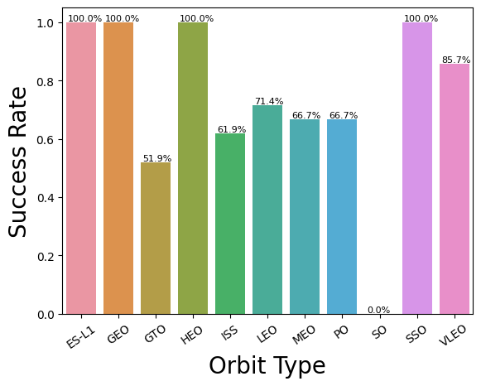
Success Rate vs. Orbit Type

Slide 21
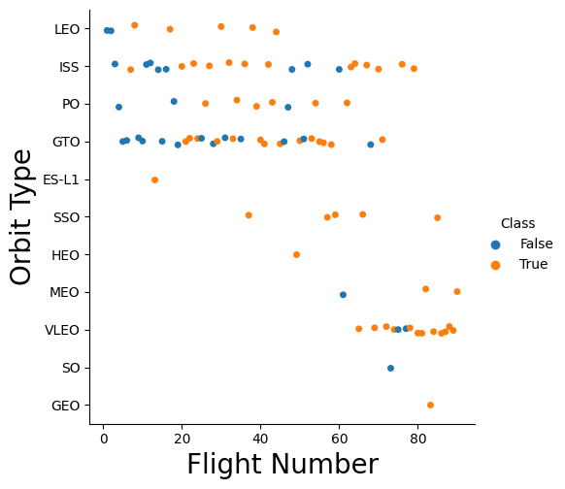
Orbit Type vs. Flight Number

Slide 22
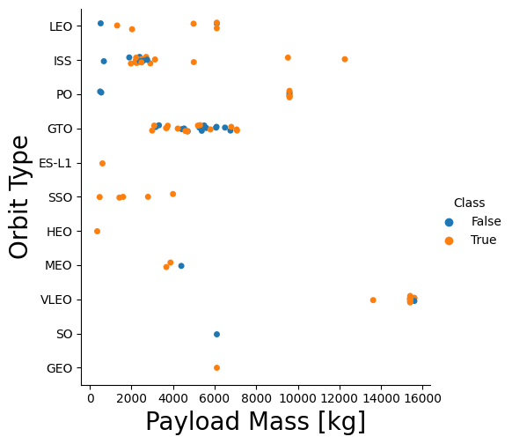
Orbit Type vs. Payload

Slide 23
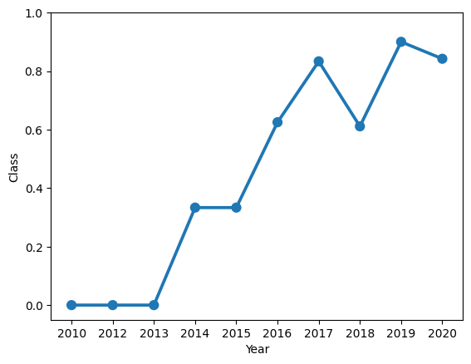
Launch Success Yearly Trend

Slide 24
All Launch Site Names
%%sql
SELECT DISTINCT Launch_Site
FROM spacex_data
ORDER BY Launch_Site;
Launch_Site
CCAFS LC-40
CCAFS SLC-40
KSC LC-39A
VAFB SLC-4E

Slide 25
Launch Site Names Begin with 'CCA'
%%sql
SELECT *
FROM spacex_data
WHERE Launch_Site like 'CCA%'
LIMIT 5;
Date | Time (UTC) | Booster_Version | Launch_Site | Payload | PAYLOAD_MASS__KG_ | Orbit | Customer | Mission_Outcome | Landing_Outcome
04-06-2010 | 18:45:00 | F9 v1.0 B0003 | CCAFS LC-40 | Dragon Spacecraft Qualification Unit | 0 | LEO | SpaceX | Success | Failure (parachute)
08-12-2010 | 15:43:00 | F9 v1.0 B0004 | CCAFS LC-40 | Dragon demo flight C1, two CubeSats, barrel of Brouere cheese | 0 | LEO (ISS) | NASA (COTS) NRO | Success | Failure (parachute)
22-05-2012 | 07:44:00 | F9 v1.0 B0005 | CCAFS LC-40 | Dragon demo flight C2 | 525 | LEO (ISS) | NASA (COTS) | Success | No attempt
08-10-2012 | 00:35:00 | F9 v1.0 B0006 | CCAFS LC-40 | SpaceX CRS-1 | 500 | LEO (ISS) | NASA (CRS) | Success | No attempt
01-03-2013 | 15:10:00 | F9 v1.0 B0007 | CCAFS LC-40 | SpaceX CRS-2 | 677 | LEO (ISS) | NASA (CRS) | Success | No attempt

Slide 26
Total Payload Mass
%%sql
SELECT SUM(PAYLOAD_MASS__KG_) as 'Total Payload Mass kg'
FROM spacex_data
WHERE UCASE(customer) LIKE '%NASA%';
Total Payload Mass kg
107010

Slide 27
Average Payload Mass by F9 v1.1
%%sql
SELECT AVG(PAYLOAD_MASS__KG_) as avg_mass
FROM spacex_data
WHERE UCASE(Booster_Version) LIKE '%F9 V1.1%';
avg_mass
2534.6667

Slide 28
First Successful Ground Landing Date
%%sql
SELECT MIN(Date) as 'First Success Ground'
FROM spacex_data
WHERE LCASE(Landing_Outcome) LIKE 'success%ground%';
First Success Ground
01-05-2017

Slide 29
Successful Drone Ship Landing with Payload between 4000 and 6000
%%sql
SELECT Booster_Version
FROM spacex_data
WHERE LCASE(Landing_Outcome) LIKE 'success%drone%'
AND PAYLOAD_MASS__KG_ BETWEEN 4000 AND 6000;
Booster_Version
F9 FT B1022
F9 FT B1026
F9 FT B1021.2
F9 FT B1031.2
F9 FT B1022

Slide 30
Total Number of Successful and Failure Mission Outcomes
%%sql
SELECT Mission_Outcome, COUNT(Mission_Outcome) as Mission_Freq
FROM spacex_data
GROUP BY Mission_Outcome;
Mission_Outcome | Mission_Freq
Success | 99
Failure (in flight) | 1
Success (payload status unclear) | 1

Slide 31
Boosters Carried Maximum Payload
%%sql
SELECT DISTINCT Booster_Version
FROM spacex_data
WHERE PAYLOAD_MASS__KG_ = (SELECT MAX(PAYLOAD_MASS__KG_)
FROM spacex_data);
Booster_Version
F9 B5 B1048.4
F9 B5 B1049.4
F9 B5 B1051.3
F9 B5 B1056.4
F9 B5 B1048.5
F9 B5 B1051.4
F9 B5 B1049.5
F9 B5 B1060.2
F9 B5 B1058.3
F9 B5 B1051.6
F9 B5 B1060.3
F9 B5 B1049.7

Slide 32
2015 Launch Records
%%sql
SELECT DATE_FORMAT(Date,"%M") as Month, Landing_Outcome, Booster_Version, Launch_Site
FROM (Select STR_TO_DATE(Date, '%d-%m-%Y') as Date, Landing_Outcome, Booster_Version, Launch_Site
FROM spacex_data) as spacex_data
WHERE LCASE(Landing_Outcome) LIKE 'failure%drone%'
AND YEAR(Date) = 2015;
Month | Landing_Outcome | Booster_Version | Launch_Site
January | Failure (drone ship) | F9 v1.1 B1012 | CCAFS LC-40
April | Failure (drone ship) | F9 v1.1 B1015 | CCAFS LC-40

Slide 33
Rank Landing Outcomes Between 2010-06-04 and 2017-03-20
Rank the count of landing outcomes (such as Failure (drone ship) or Success (ground pad)) between the date 2010-06-04 and 2017-03-20, in descending order
Present your query result with a short explanation here
%%sql
SELECT Landing_Outcome, COUNT(Landing_Outcome) as Landing_Outcome_Freq
FROM (Select STR_TO_DATE(Date, '%d-%m-%Y') as Date, Landing_Outcome
FROM spacex_data) as spacex_data
WHERE LCASE(Landing_Outcome) LIKE '%success%'
AND Date BETWEEN CAST('2010-06-04' AS DATE) AND CAST('2017-03-20' AS DATE)
GROUP BY Landing_Outcome
ORDER BY Date DESC;
Landing_Outcome | Landing_Outcome_Freq
Success (drone ship) | 5
Success (ground pad) | 3

Slide 34

Section 3

Slide 35
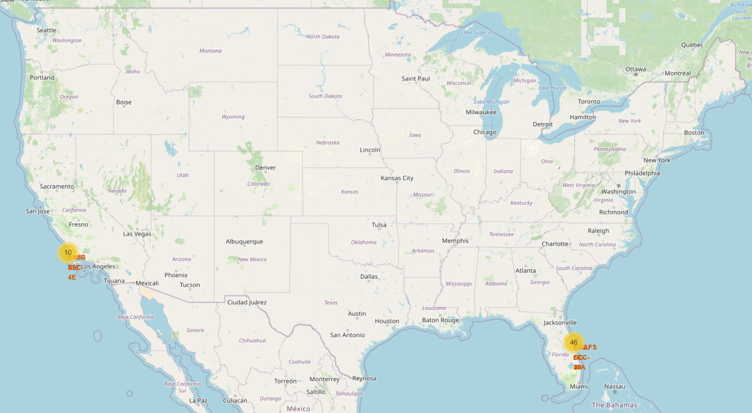
<Folium Map Screenshot 1>

Slide 36
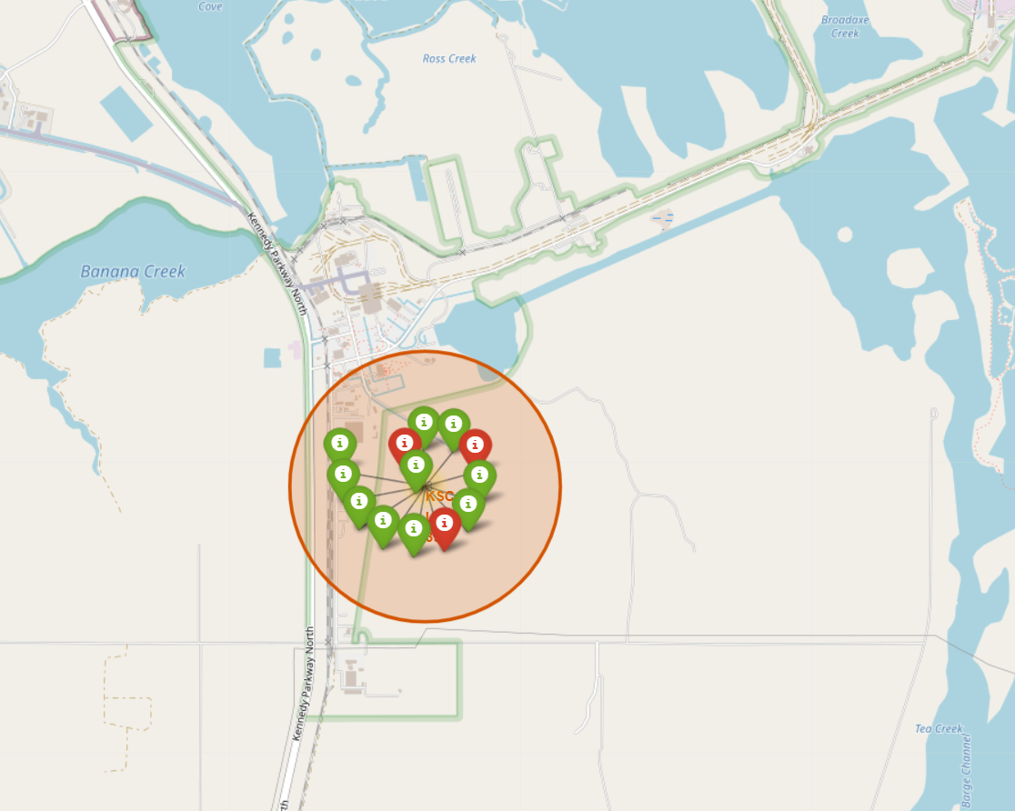
<Folium Map Screenshot 2>

Slide 37
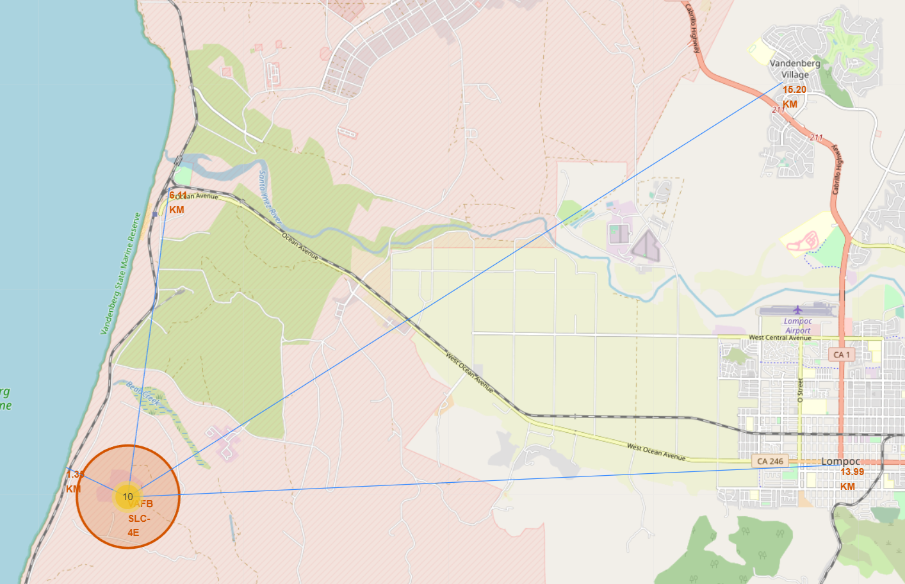
<Folium Map Screenshot 3>

Slide 38

Section 4

Slide 39
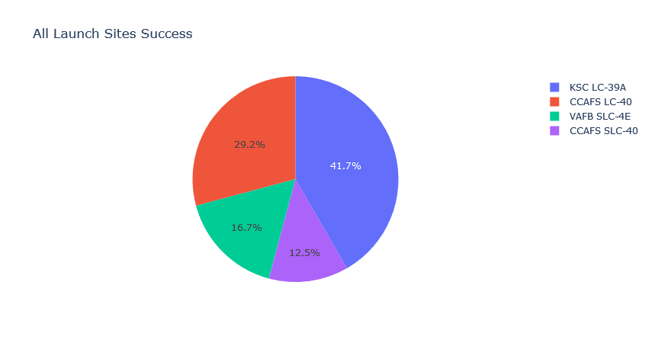
Success Rate Share per Site

Slide 40
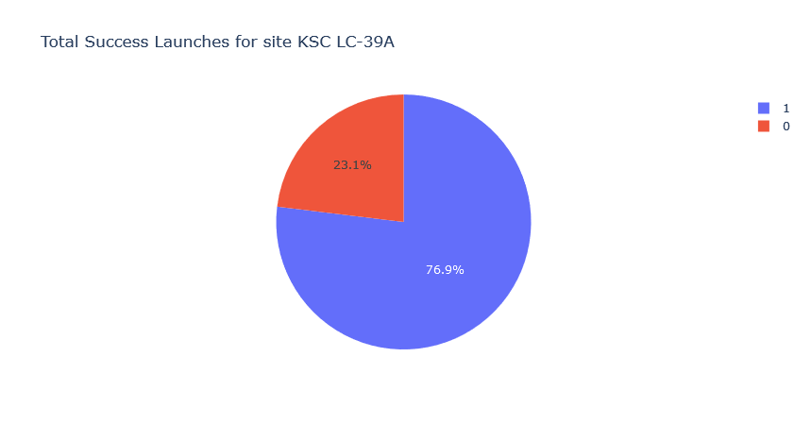
Highest Success Percentage

Slide 41
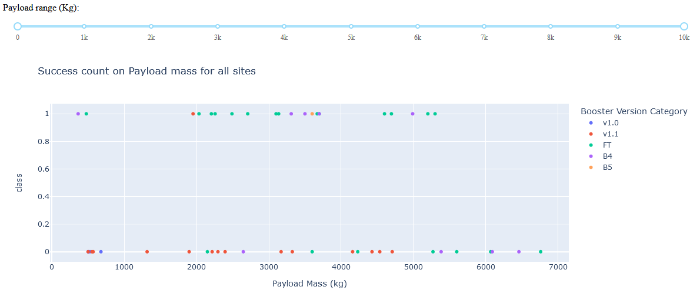
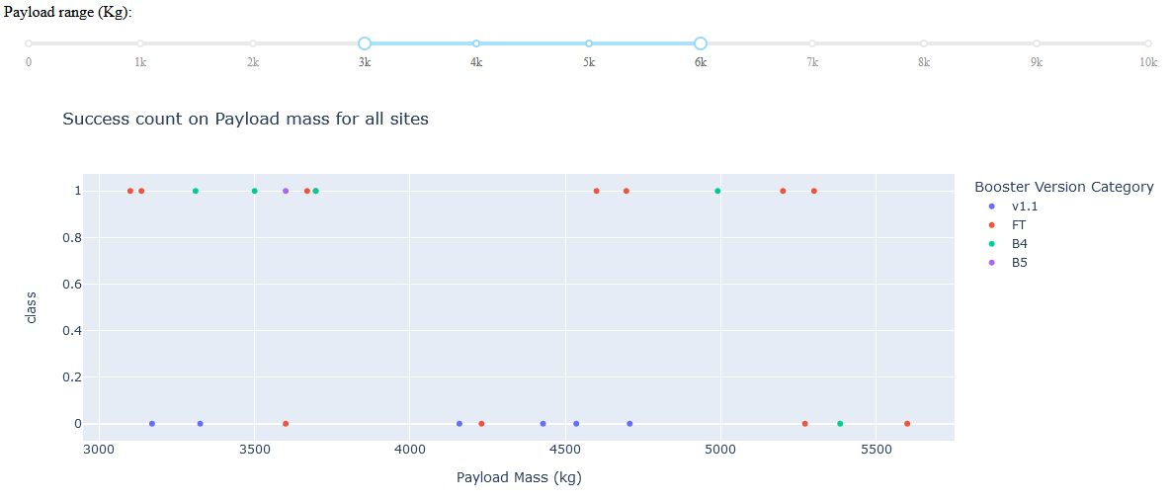
Successes in Payload Mass Range
All Sites

Slide 42

Section 5

Slide 43
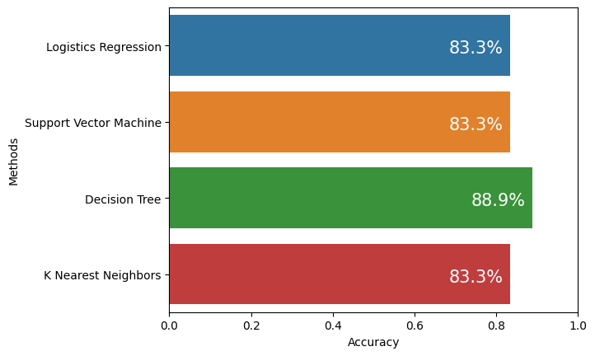
Classification Accuracy
Visualize the built model accuracy for all built classification models, in a bar chart
Find which model has the highest classification accuracy

Slide 44

Confusion Matrix
Show the confusion matrix of the best performing model with an explanation

Slide 45
Conclusions
Point 1
Point 2
Point 3
Point 4
…

Slide 46
Appendix
Include any relevant assets like Python code snippets, SQL queries, charts, Notebook outputs, or data sets that you may have created during this project

Slide 47


